Slide 2
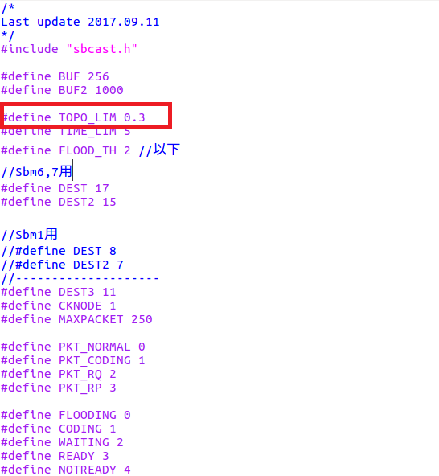

Slide 3
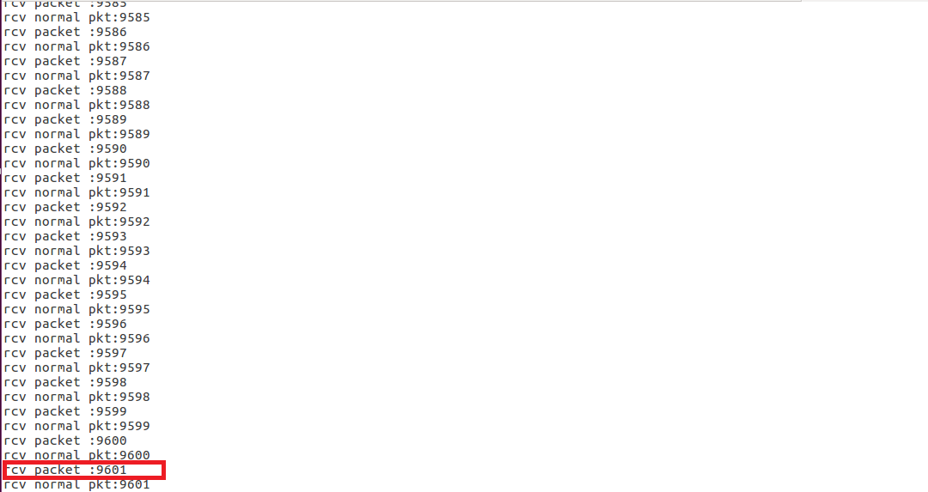

Slide 4
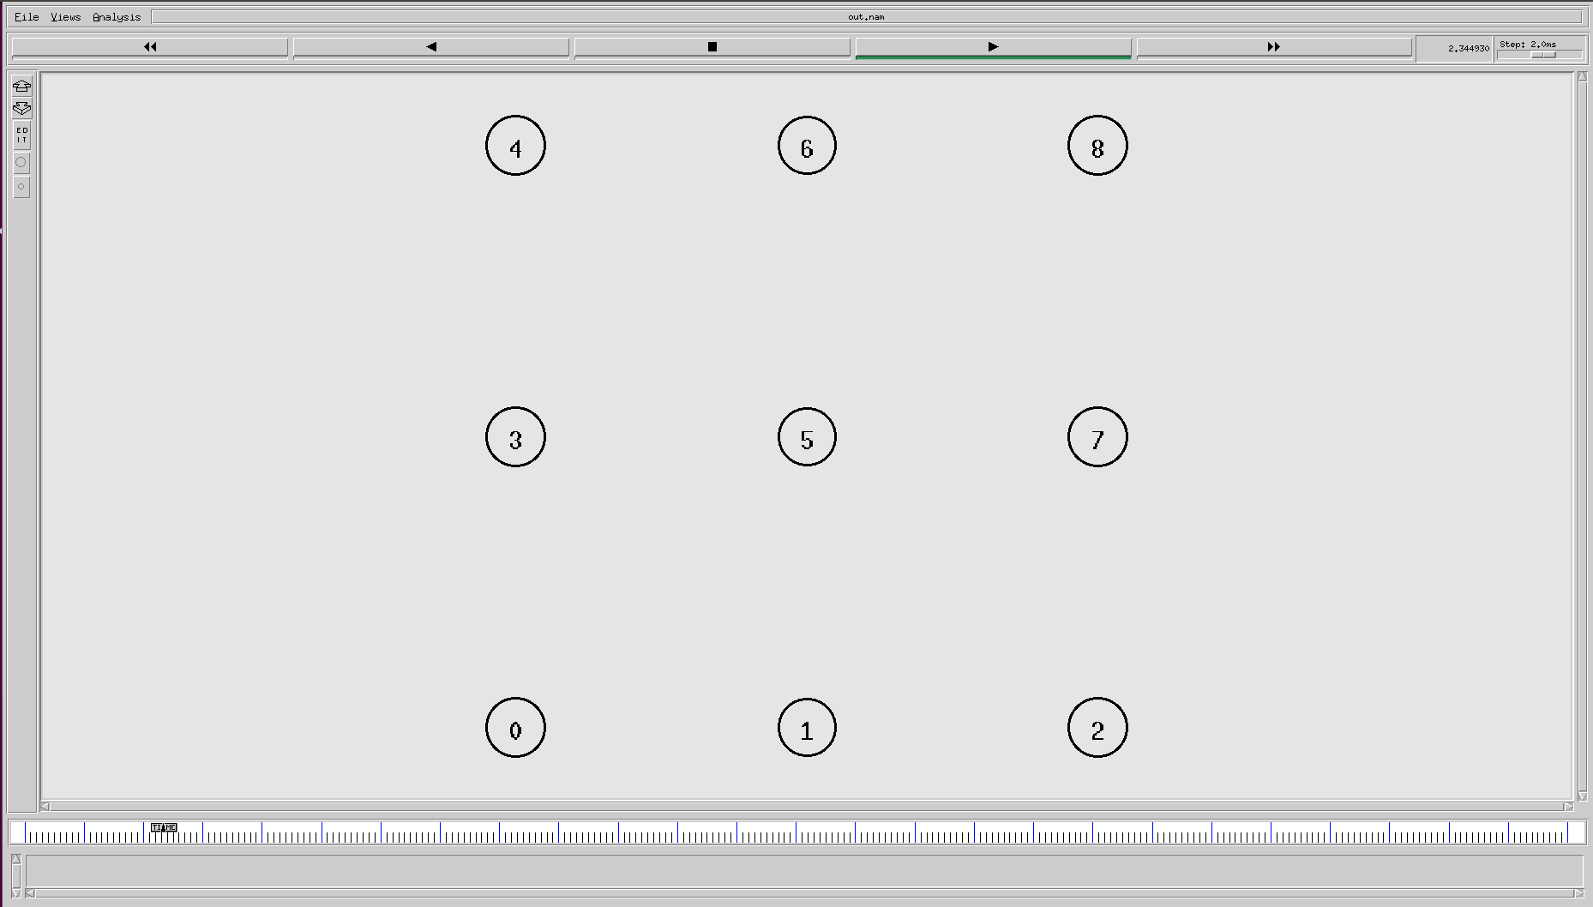
Experiment 1

Slide 5
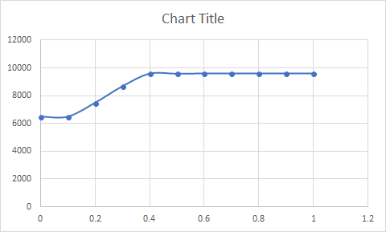
Using Network Coding | Number Of Packets in the Network
0 | 6479
0.1 | 6479
0.2 | 7481
0.3 | 8682
0.4 | 9598
0.5 | 9590
0.6 | 9611
0.7 | 9611
0.8 | 9611
0.9 | 9611
1 | 9611
Highest : 9611 at 0.6 to 1.0
Lowest : 6479 at 0-0.1

Slide 6
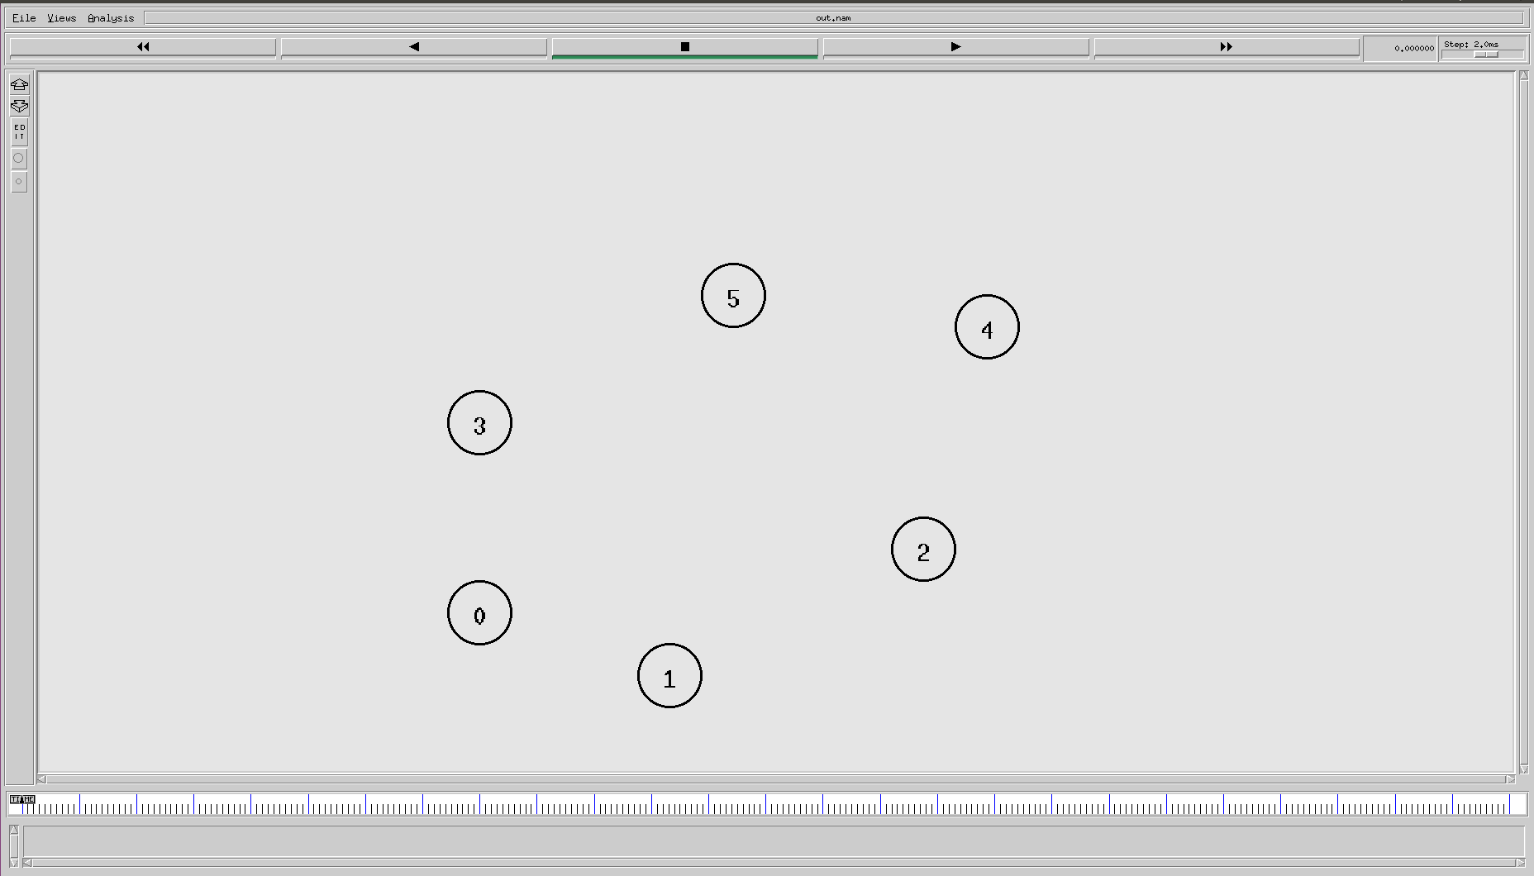
Experiment 2

Slide 7
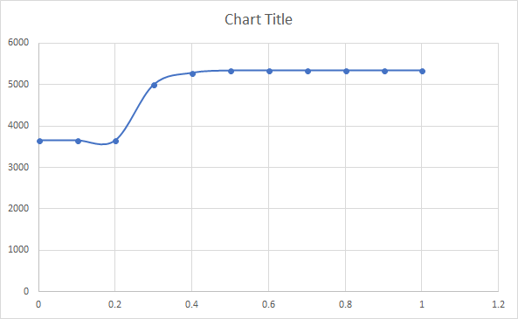
Using Network Coding | Number Of Packets in the Network
0 | 3654
0.1 | 3654
0.2 | 3654
0.3 | 5001
0.4 | 5289
0.5 | 5345
0.6 | 5345
0.7 | 5345
0.8 | 5345
0.9 | 5345
1 | 5345
Highest : 5345 at 0.5 to 1.0
Lowest : 3654 at 0 to 0.2

Slide 8
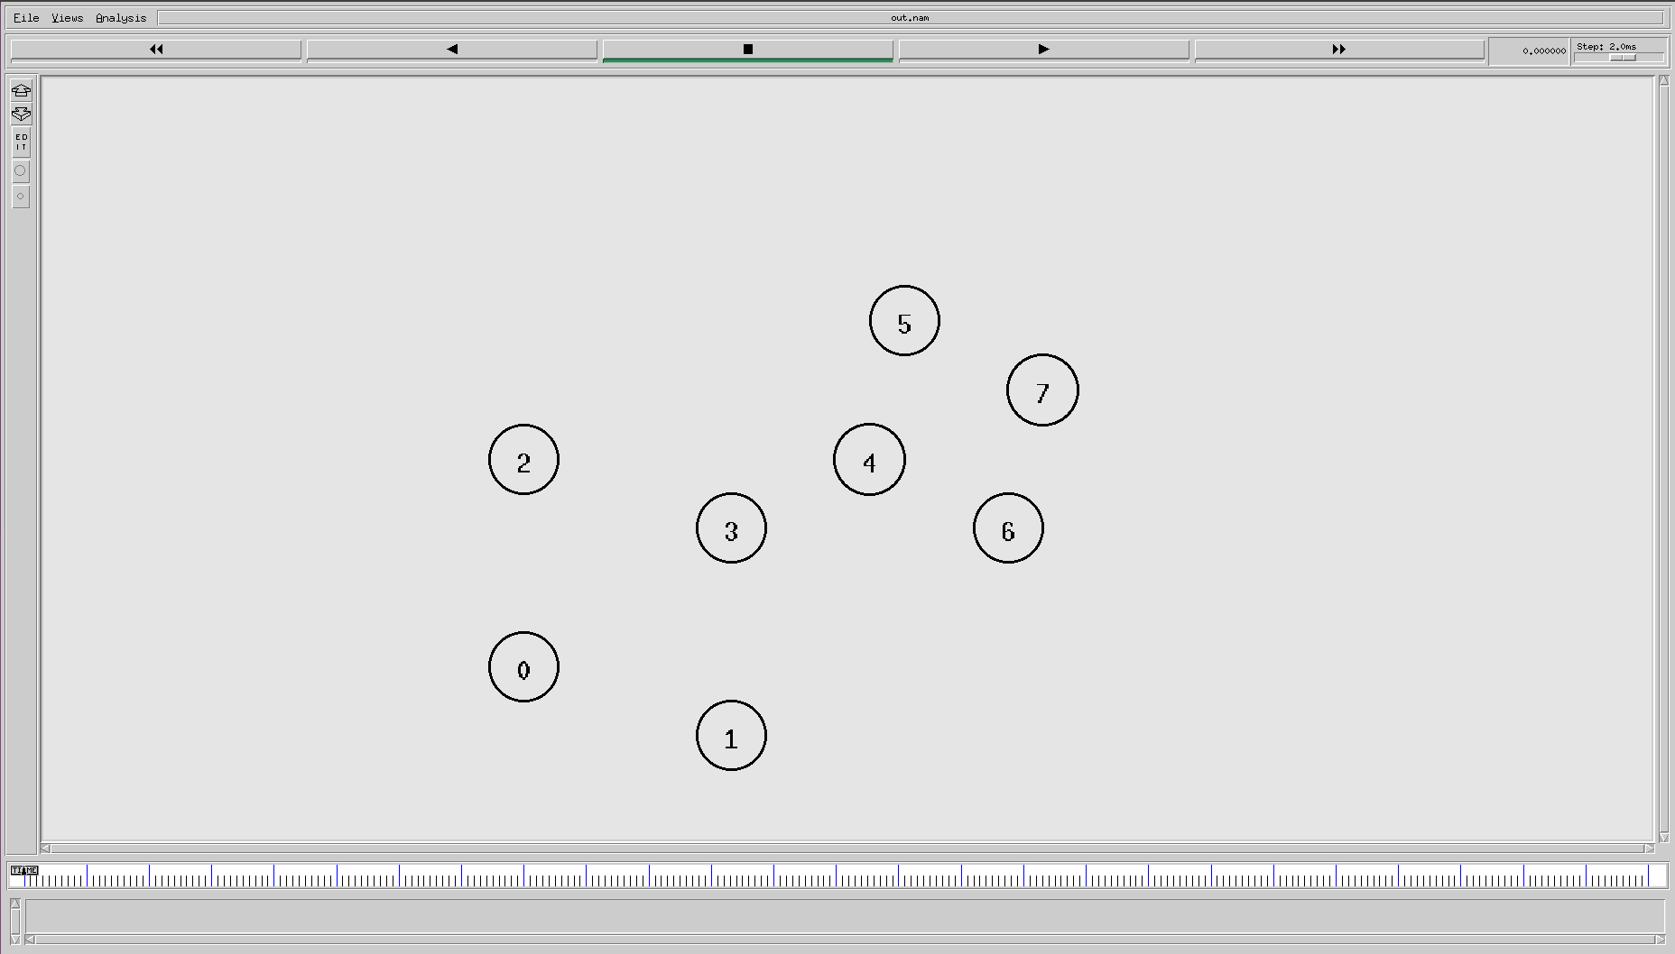
Experiment 3

Slide 9
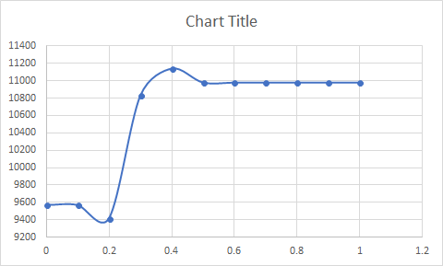
Using Network Coding | Number Of Packets in the Network
0 | 9569
0.1 | 9569
0.2 | 9416
0.3 | 10832
0.4 | 11143
0.5 | 10982
0.6 | 10982
0.7 | 10982
0.8 | 10982
0.9 | 10982
1 | 10982
Highest : 11143 at 0.4
Lowest : 9416 at 0.2

Slide 10
Script

